Slide 1

Marketing Mix - Price
Lecturer: Nguyễn Quỳnh Hoa, PhD
Email: hoa.nguyenquynh@hust.edu.vn

Slide 2

Objectives
Explain what price is and why pricing matters.
Compare major pricing approaches.
Identify internal and external factors affecting pricing.
Explain new-product and product-mix pricing strategies.
Apply price-adjustment strategies.
Understand how firms initiate and respond to price changes.

Slide 3
What is price?
Price is the sum of all the values customers give up to gain the benefits of having or using a product or service.
Money
Time
Effort
Convenience
Opportunity
Eg: A low-cost airline ticket may be cheap in money but expensive in:
travel time,
baggage charges,
airport distance,
inconvenience.

Slide 4
Why price is important to a business?
Price is the only element of the marketing mix that directly produces revenue.
Price helps to position its brand in the market and customers’ perception
Eg: Rolex → high price → The price communicates: Luxury , Status, Craftsmanship, and Exclusivity
Price helps to compete with other providers
Eg: “Who says their price is lowest, we can be lower”
Price helps to prevent newcomers to the market

Slide 5
Price-beat guarantee: NZ Pharmacy
Bargain Chemist
Chemist Warehouse
If a customer finds the same item at a cheaper price at another New Zealand retail store, Chemist Warehouse will match that price and give 10% off the difference.
if Chemist Warehouse sells an item for NZ$50 and another eligible retailer sells the exact same item for NZ$40:
Difference = NZ$10
10% of the difference = NZ$1
Chemist Warehouse price = NZ$39
So it is technically a price-beat, not just a price-match policy.
if a customer finds a cheaper everyday price on an identical, in-stock item at a New Zealand pharmacy, Bargain Chemist will beat the difference by 10%.
Bargain Chemist price: NZ$50 Another NZ pharmacy sells the identical product for: NZ$40
Difference = NZ$10
Bargain Chemist beats the difference by 10%:
10% × NZ$10 = NZ$1
So the final price would be:
NZ$40 − NZ$1 = NZ$39

Slide 6
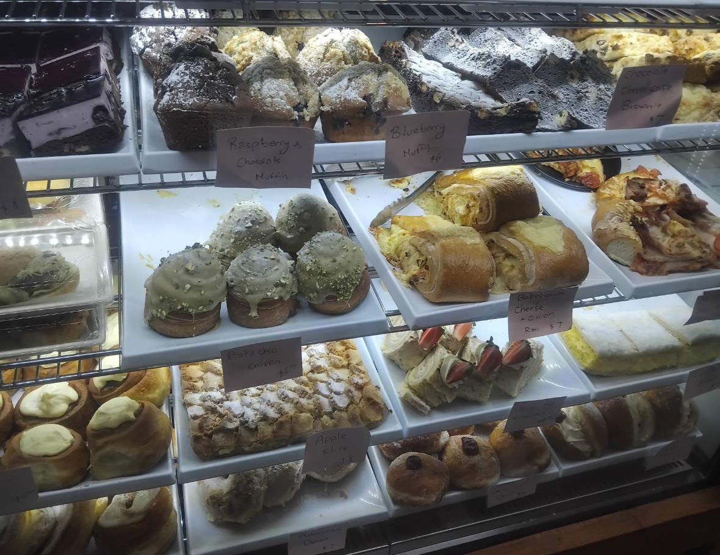
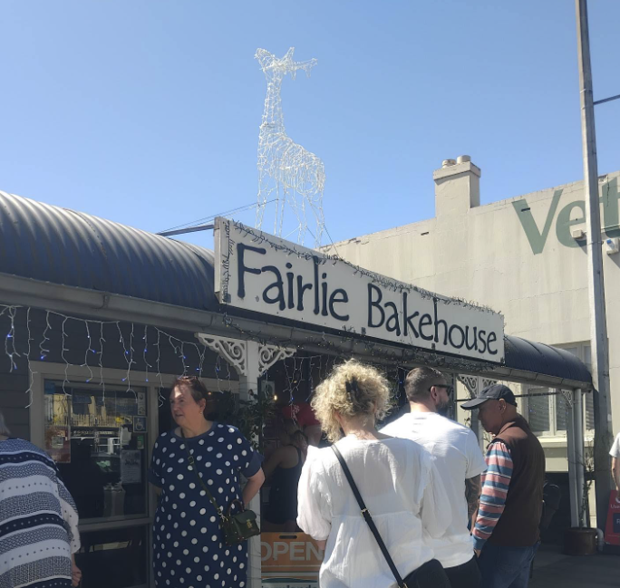
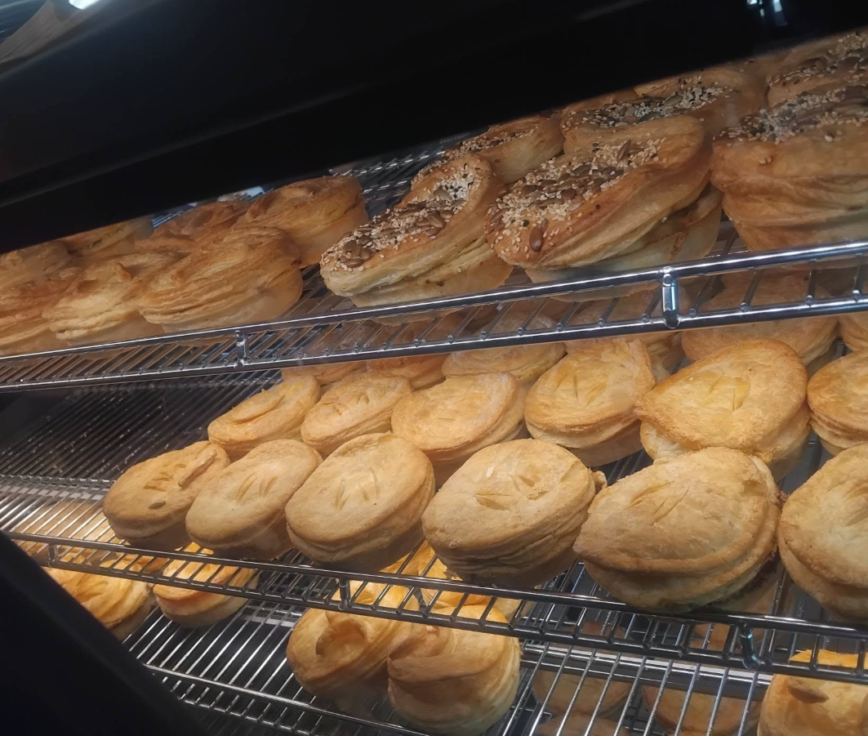
Meat pie price war
For many years, Fairlie Bakehouse had been a well-known local bakery in Canterbury, New Zealand. It was especially famous for its meat pies, which had won several local food awards for taste and quality. Because of its strong reputation and loyal customer base, the bakery sold its award-winning meat pie for NZ$8.50 and maintained a healthy profit margin.
A new bakery, Golden Crust, then announced plans to open nearby. To attract customers, Golden Crust planned to sell a similar meat pie for NZ$7.50. Just before the new bakery opened, Harbour Bakery reduced the price of its meat pie from NZ$8.50 to NZ$5.50. It also introduced temporary discounts on sausage rolls, sandwiches, and other popular bakery items.
Harbour Bakery could afford the lower prices for a period because it already had an established customer base, strong brand recognition, and stable supplier relationships. Golden Crust, however, faced high start-up costs and needed time to build its own customer base. At the much lower market price, it struggled to compete profitably. After several months, Golden Crust closed its shop.
Once the new competitor had left the market, Harbour Bakery gradually raised the price of its award-winning meat pie back towards NZ$8.50 and ended most of its temporary discounts.

Slide 7
Price and Value
Value: The benefits customers perceive when using a product or service.
Eg: Women do not simply buy lipstick → they buy something that helps them feel more beautiful.
“No one sells a comb to a monk.” → A product has little value if it does not match the customer’s needs.
“Fish do not eat bread; they eat worms.” → Customers respond to what they want, not necessarily to what the seller prefers to offer.
Perceived cost: Not only the money paid, but also the time, effort, risk, and inconvenience involved.
Perceived value = Perceived benefits – Perceived costs
→ The selling price should reflect customers’ perceived value.
Eg: A raincoat priced at VND 100,000. On a sunny day: customers may perceive it as expensive. During heavy rain: customers may perceive it as cheap.
Perceived value can also change depending on customer needs, income, usage situation, brand, competition, seasonality, emotions, perceived risk, and timing.
Prices often adjust with a time lag because firms cannot—or may not want to—change prices immediately. Price adjustments may be delayed by contracts, posted price lists, menu costs, brand strategy, customer psychology, or competitive considerations.

Slide 8
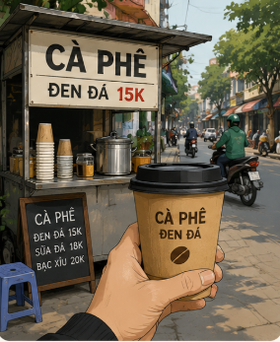
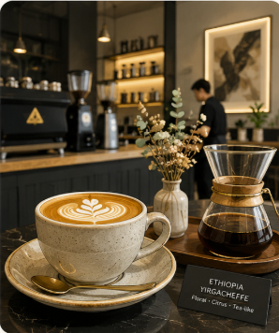
Coffee
Suppose coffee beans, milk and a cup cost only a small amount.
Yet customers may pay:
Street coffee: 15k VND
Café coffee: 30k VND
Premium speciality café: 50k VND
Why? → Customers are buying more than coffee:
Convenience
Atmosphere
Location
Service
Brand
Social experience
A place to catch up with friends and business
Customers pay for perceived value, not merely production cost.
“Am I getting good value for what I pay?” → Fair price, not lowest price

Slide 9
Price strategy
Everyday Low Pricing - EDLP
High-Low Pricing
Maintain relatively low prices consistently.
Eg: Walmart: “You do not need to wait for a sale.”
Charge higher regular prices but frequently offer promotions.
Eg: Alfresco Pizza: Sale off 50% for large pizza every Thursday

Slide 10
Value-Added Pricing
When competitors reduce price, should a business reduce its price, too? Why and Why not? When and How?
Value-added pricing: Adding features and services to differentiate an offer and support a higher price.
Eg: Instead of selling a hotel room:
→ Room + breakfast + airport transfer + late checkout
Instead of discounting a laptop:
→ Laptop + warranty + technical support
Principle: Add value rather than simply cut price. Why?

Slide 11
Discussion: When price fails to keep pace with perceived value, pricing opportunities or risks may arise.
Price < Perceived value
Price > Perceived value
Opportunity:
Increase the price
Introduce a more premium version
Offer a premium package
Reduce promotions
Increase the profit margin
Move the brand to a higher market position
Eg: A bottle of water: VND 10,000 At the airport: VND 50,000
Risk:
Customers may decide not to buy
Customers may switch to competitors
Customers may perceive the price as “too expensive”
The brand may lose customer trust
The business may be forced to offer deep discounts
Customers may complain or boycott the brand
Eg: A bowl of pho: 80.000 VND, but the restaurant is noisy, dirty, slow in service, hot and uncomfortable, poor wifi → Perceived cost increase → Perceived value drops → the customer may think: “This is too expensive for what I get.” → No repeat purchase, negative WOM, poor online review

Slide 12

Price vs. Cost

Slide 13
Types of costs
Eg 1: Cost per Unit: Cocoon Pomelo Shampoo
Suppose Cocoon produces 10,000 bottles of Pomelo shampoo per month
VC per bottle:
Suppose monthly fixed production costs are:
Factory and equipment: VND 60 million
Salaries and supervision: VND 35 million
Quality control and administration: VND 25 million
Total fixed costs = VND 120 million
FC per unit = 120 m/ 10,000 = 12,000 VND
Cost per unit = 70,000 + 12,000 = 82,000 VND
Current price = 261,000 VND
Distribution, retail margins, mkt, promotion, taxes and other costs
Fixed costs (FC): Costs that do not vary directly with production or sales.
Eg: Rent, Salaries, Insurance, Equipment leases, Depreciation of fixed assets
Variable costs (VC): Costs that change with the level of production.
Eg: Ingredients, Packaging, Components, Delivery
Total costs (TC) = FC + VC
Cost item | Cost/bottle
Ingredients | VND 35,000
Bottle, pump and label | VND 18,000
Production labour | VND 8,000
Packaging | VND 5,000
Variable production costs | VND 4,000
Total variable cost | VND 70,000

Slide 14
Type of cost: Service Under the Canopy Homestay: Cost per Room-Night
Suppose Under the Canopy has two guest rooms
Maximum monthly capacity: 2 rooms×30 nights=60 room-nights
Suppose monthly fixed costs are:
But the homestay does not necessarily
sell all 60 room-nights.
Suppose occupancy is 75%:
60×75%=45 occupied room-nights
FC per occupied room per night
= 36 M / 45 = 800,000 VND
Suppose the VC for each guest stay →
TC per occupied room per night
800,000 + 250,000 = 1,050,000 VND
How this TC change
If in spring, the occupancy falls to 50%?
If in autumn, the occupancy rises to 90%?
Fixed cost | Monthly cost
Property cost/depreciation | VND 18 million
Staff/host | VND 10 million
Internet, administration, maintenance | VND 5 million
Marketing and other fixed costs | VND 3 million
Total fixed costs | VND 36 million
Variable cost per occupied room-night | Cost
Cleaning | VND 100,000
Laundry | VND 60,000
Electricity and water | VND 50,000
Toiletries, drinking water, etc. | VND 40,000
Total variable cost | VND 250,000

Slide 15
Break-Even Analysis
Variable cost per bottle = Purchase cost + Packaging cost
Contribution per unit = Price − Variable cost
Q*= FC/ (P – VC)
Profit = TR – TC = TR – (FC + VC)
Break-even point: The sales volume at which Total Revenue (TR) = Total Costs (TC).
Break-even volume (Q*) = Fixed costs (FC) / (Price (P) – Variable costs (VC))
Contribution per unit (Lãi gộp đơn vị) = P - VC
Eg: A store sells thermal water bottles.
Monthly fixed costs: VND 24,000,000
Purchase cost per bottle: VND 120,000
Packaging cost per bottle: VND 10,000
Market selling price: VND 250,000 per bottle
The store decides to sell at the same market price.
Questions: How many bottles must the store sell per month to break even? If the store sells 250 bottles per month, will it make a profit or a loss? How much will the profit or loss be?
VC = 120,000 + 10,000 = 130,000 VND
P – VC = 250,000 – 130,000 = 120,000 VND
Q* = Fixed costs ÷ Contribution per unit
= VND 24,000,000 ÷ VND 120,000 = 200 bottles
If they sells 250 bottles
TR = 250 x 250,000 = 62,500,000 VND
VC = 250 x 130,000 = 32,500,000 VND
TC = 24M + 32.5M = 56,500,000 VND
Profit = TR – TC = 6,000,000 VND

Slide 16
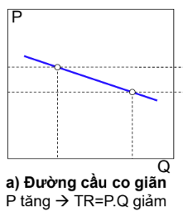
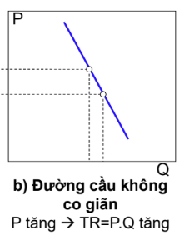
Price Elasticity of Demand
Price elasticity measures how much demand responds (in %) to a 1% change in price.
When price varies, how do customers react?
Ed​= % change in demand/ % change in price
|Ed| > 1: Elastic demand Small price change → large change in demand. Eg: milk tea, movie ticket
|Ed| < 1: Inelastic demand: Price changes have relatively little effect on demand. Eg: Rice, urgent purchases
|Ed| = 1: unit elastic demand
Price is less sensitive if the product is unique, quality is difficult to compare, there are few substitutes, someone else pays, switching costs are high, the product has strong emotional or symbolic value.
Eg: A milk tea shop raised its price from 70,000 to 77,000 VND per cup. The sales per day decreased from 1000 cups to 750 cups. Calculate the Ed and analyse its meaning.

Slide 17

Price decision

Slide 18
Price decision influencing factors
Inner factors
Outside factors
Manufacturing and management cost
Target goals and profits
Mkt focus: Brand positioning/ target market/ gain market shares/ niche market
Macroenvironment
Competitors
Customer behaviour

Slide 19
Price target
Profit
Revenue/ Market share
Others
Maximise profit
Target revenue
No loss
Survive
Maximise sales volume / market share (market expansion)
Maximise revenue (e.g. before withdrawing from the market)
Achieve a target level of sales / market share
Prevent competitors from gaining market share
Positioning: price leadership / quality leadership
Price stabilisation
Survival during difficult market conditions

Slide 20
Cost-plus pricing / markup pricing
Adding a standard markup to the cost of the product.
Example:
Product cost = $80
Desired markup = 25%
Price:
$80 + $20 = $100
Advantages:
Simple
Easy to administer
Useful when costs are predictable
Limitation: It ignores customer willingness to pay

Slide 21
COMPETITION-BASED PRICING
Pricing | Meaning | Eg
Equal to the market/ competitors | when products are difficult to differentiate | Petrol stations
Less than competitors | to attract price-sensitive customers | Low-cost airlines
Higher than competitors | when it offers superior value | Luxury hotel vs budget hotel
Follow the leader | Smaller brands adjust their prices in response to the market leader’s pricing. | Milk market
Bench marking: A pricing method based on comparing a company’s prices with competitors’ prices, the market average, or industry benchmarks, and then setting an appropriate price for its own product or service.

Slide 22
Setting prices
Customers often compare alternatives.
Eg: A traveller comparing:
Vietnam Airlines – VietJet – Bamboo Airways
may evaluate fare, baggage, schedule, service, reliability, not price alone.
Pricing cannot be decided independently. A brand positioned through its product, packaging, distribution, promotion, price.

Slide 23
NEW-PRODUCT PRICING
Market-penetration pricing: start low
Market-skimming pricing: start high
Setting a relatively low initial price to attract many buyers quickly and gain market share.
Low price → Rapid adoption → Large sales volume → Lower unit costs → Strong market position
Eg: A new pizza brand enters Vietnam
Instead of charging 300.000 VND/ pizza like other brands on the market, it launches at 49,000 VND/ pizza
Objective: Encourage trial, Build membership, Create habits, Gain market share quickly → Later, prices may increase.
Setting a high initial price to “skim” revenues from customers willing to pay more.
Price may later decline.
Suitable when:
Product quality/image supports high price.
Enough customers are willing to pay.
Competitors cannot easily enter.
Small production volume does not make costs too high.
Eg: iPhone, laptop, car

Slide 24
Product Mix Pricing
Most companies sell several related products.
Therefore, they must price the whole product mix, not each product independently.
Main approaches include:
Product line pricing
Optional-product pricing
Captive-product pricing
By-product pricing
Product bundle pricing

Slide 25
Product Line Pricing
Setting price differences among products in a product line.
Example:
iPhone family:
Basic model → Higher specification model → Premium model
Price steps signal differences in:
Features
Performance
Status
Customer value

Slide 26
Optional-Product Pricing
Pricing optional or accessory products sold with the main product.
Example:
Buying a car:
Base price and
Better sound system
Leather seats
Special wheels
Driver-assistance package
The base price attracts interest, while options increase revenue.

Slide 27
Captive-Product Pricing
Captive-product pricing
Pricing products that must be used with the main product.
Examples:
Printer → Ink
Coffee machine → Capsules
Razor → Replacement blades
Sometimes:
Main product = relatively inexpensive
Captive product = higher-margin recurring purchase

Slide 28
Product Bundle Pricing
Combining several products and offering the bundle at a reduced combined price.
Examples:
McDonald's meal
Burger + fries + drink
Microsoft 365
Word + Excel + PowerPoint + other services
Hotel package
Room + breakfast + spa
Bundles can:
Increase perceived value
Encourage customers to buy more
Simplify purchase decisions

Slide 29
Base price
Base price is the initial or standard price that a company uses as the starting point for determining the final selling price.
From the base price, the company may add or subtract factors such as:
discounts;
promotions;
taxes;
delivery charges;
service fees;
surcharges;
additional support packages;
seasonal, geographic, or customer-segment adjustments.
A base price can also give salespeople more flexibility in negotiation while still protecting the company’s profit target.

Slide 30
Example:
Target price required to achieve the desired profit: VND 600,000
Base price: VND 1,000,000
Bulk-purchase discount: 20%
Final selling price:
VND 1,000,000 × 0.8 = VND 800,000
→ The negotiated price is still above the VND 600,000 profit-target level.

Slide 31
Price Adjustment as a marketing tool

Slide 32
Price Adjustment Strategies
Discount and allowance pricing
Segmented pricing
Psychological pricing
Promotional pricing
Geographical pricing
Dynamic pricing
International pricing

Slide 33
Discounts and Allowances
Discount
Allowance
A direct reduction in price.
Eg:
Pay within 10 days → 2% discount
Buy 10, get a lower unit price
Under the Canopy launch promotion offered 15% off all bookings
A promotional reduction for certain customer actions.
Eg:
Trade in your old phone and receive $200 toward a new one.
Introduce 3 new customers, get 10% off for the next purchase

Slide 34
Segmented pricing
Selling a product or service at different prices even though the differences are not based primarily on differences in cost.
Customer-segment pricing
Student ticket
Senior discount
Product-form pricing
Different versions
Location pricing
Concert seats
Time pricing
Peak vs off-peak prices
Eg: Passengers on the same flight may pay very different fares, depending on: booking date, travel date, demand, refund conditions, baggage, seat class, customer flexibility, services → Same aircraft, same destination, but different customer conditions and willingness to pay.

Slide 35
Hanoi Five Gates Heritage Train - Product-line / segmented pricing
The Hà Nội 5 Cửa Ô (The Hanoi Train) currently uses three ticket levels:
First-floor seat: VND 550,000
Second-floor seat: VND 650,000
Second-floor VIP seat: VND 750,000
The published fare structure therefore creates VND 100,000 price steps between the three levels.
the physical transportation from Hanoi to the destination is broadly the same, but customers pay more for differences in experience, seating and exclusivity.
Why different prices rather than one price for everyone?

Slide 36
Psychological Pricing
Meaning of price: $9.99 instead of $10; or $68 instead of $70
A higher price may sometimes signal higher quality
Eg: TH true MILK vs Vinamilk: similar 180 ml cartons of fresh UHT milk
Vinamilk: 4 × 180 ml = VND 35,000
TH true MILK: 4 × 180 ml = VND 39,100
TH deliberately communicates a “clean, fresh, farm-to-table” positioning. The customers may think “TH is slightly more expensive. Perhaps it is fresher, cleaner, more natural, or higher quality. But the different of price is not much, I can pay a little higher for better quality for my children” → psychological effect.
Price itself becomes part of the brand positioning.

Slide 37
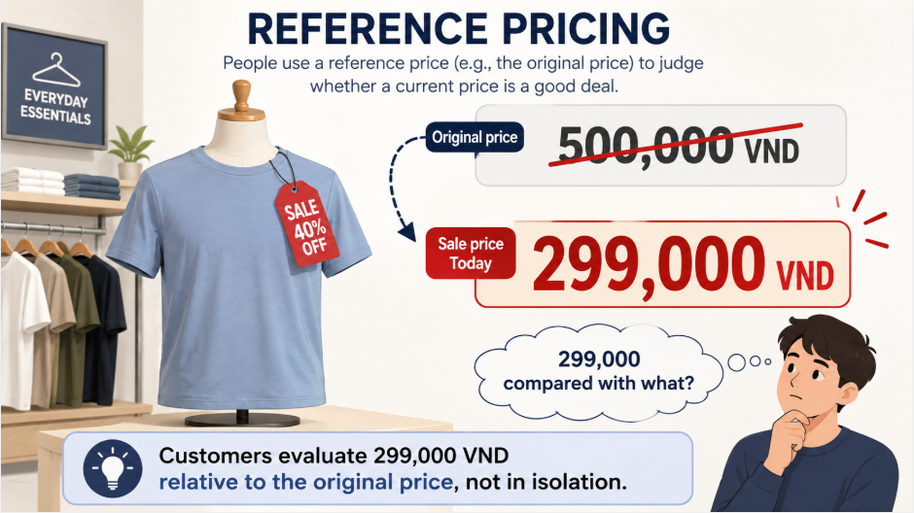
Reference Prices
A shop reduces its price during the Black Friday period. After that, the price goes back to the original price.
The original price becomes a reference point
Flash sales, coupons, limited-time discount, buy 1 get 1 free, etc.
Anchor price:
A mall sells bottled water at: 10,000 VND/ bottle; and 24,000VND/ pack of 3 bottles
A customer may buy 1 pack to get 3 bottles at lower price → 10,000 VND is the reference price → anchor price
Another customer may buy 1 bottle as they don’t want to buy more than their need.
In fact, VND 8,000 already gives the seller the desired profit. The seller earns benefit either way.

Slide 38
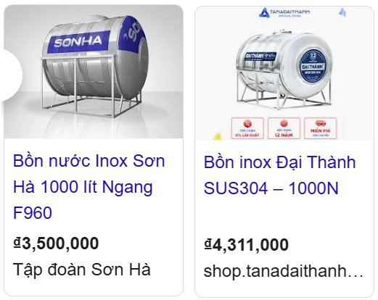

Initiating Price Raise
Rising costs
Inflation
Strong demand
Supply shortages
Improved product value
Risks:
Avoid making customers feel that the company is taking advantage of the situation. Eg: raising prices when fuel prices increase.
Inform customers clearly in advance before increasing prices.
Provide a brief and easy-to-understand explanation for the increase.
Consider alternative measures before raising the headline price, such as:
removing discounts;
reducing complementary/support services.
Include price-adjustment clauses in contracts to protect against future cost increases.

Slide 39
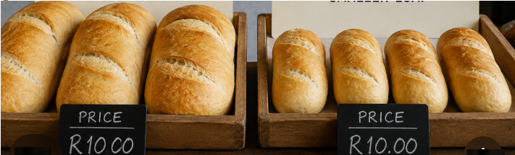
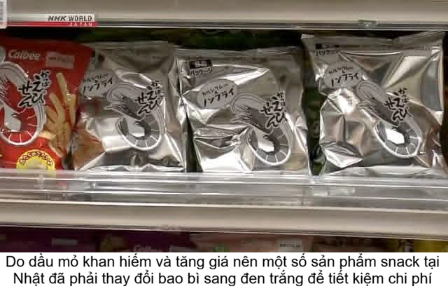
Instead of simply increasing price, firms may:
Reduce package size
Remove discounts
Charge separately for services
Introduce a premium version
Reduce product size or quantity → Shrinkflation
Source cheaper raw materials
Simplify product features or service elements
Use lower-cost packaging, or encourage customers to buy in larger quantities to reduce packaging and distribution costs
Introduce a new, lower-priced brand
Eg: Lancôme / YSL Beauty / Giorgio Armani Beauty → L’Oréal Paris / Maybelline / Garnier

Slide 40
Initiating Price Cuts
Excess capacity
Falling demand
Strong competition
Desire to increase market share
Lower production costs
Recover the investment quickly
Create barriers to discourage new competitors from entering the market
VD: Shopee vs. Temu
Risk: Customers may think:
“Is the product selling badly?”
“Is quality falling?”
“Will the price fall again?”

Slide 41
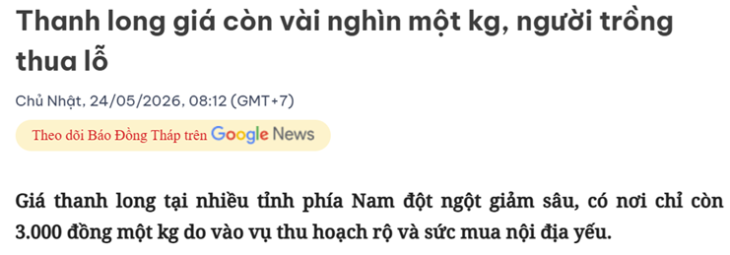
Dragon fruit prices fall to only a few thousand dong per kilogram, leaving growers at a loss
Sunday, 24 May 2026, 08:12 (GMT+7)
Dragon fruit prices in many southern provinces have suddenly fallen sharply, dropping to as little as VND 3,000 per kilogram in some areas due to peak harvest season and weak domestic demand.
In Lam Dong Province (formerly Binh Thuan), Ms Luong, who owns a 4,000 m² dragon fruit farm, said that since the beginning of May, prices have continuously declined and fluctuated significantly. At present, traders are buying Grade 1 white-fleshed dragon fruit for around VND 7,000–8,000 per kilogram, while Grade 2 fruit is selling for only VND 3,000–6,000 per kilogram, and is still difficult to sell.
Current prices are approximately 50–70% lower than at the beginning of the year, depending on the variety and quality.

Slide 42
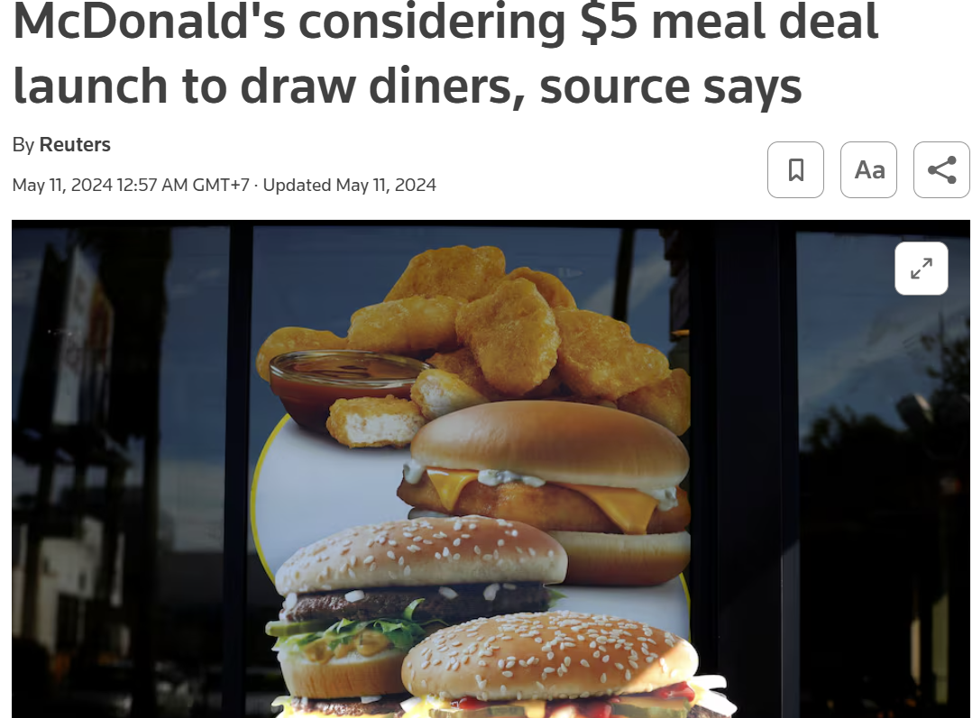
McDonald’s lowers prices through value meal deals
In 2024, McDonald’s in the United States considered launching a US$5 meal deal to attract customers affected by inflation. Reuters described the move as an effort to bring inflation-hit customers back to its restaurants.
By 2025, value meals and promotional offers continued to support McDonald’s sales performance. Reuters reported that U.S. comparable sales rose 2.4% in the third quarter of 2025, helped by value-oriented offers and meal deals, while lower-income consumers remained under financial pressure.

Slide 43
Risks
Reduce the brand’s perceived value
Train customers to wait for promotions
Reduce profit margins
Damage the brand image
“Easy come, easy go”: discounts may attract price-sensitive customers who are not loyal
Trigger price wars and make it difficult to return to the original price level

Slide 44
Responding to Competitor Price Changes
Suppose your competitor reduces its price by 20%.
Should you immediately match it?
First ask:
Why did the competitor change its price?
Is the price cut temporary or permanent?
How will customers respond?
What happens to our market share?
What happens to our profit?
Can we respond without cutting price?
Possible responses:
Maintain price
Improve perceived value
Improve quality
Introduce a lower-price brand
Match the competitor's price

Slide 45
Questions:
What are the potential costs or negative consequences of matching a competitor’s price cuts?
Why can the same price be perceived as “cheap” by one customer but “expensive” by another? Explain using perceived value, perceived cost, reference price, and purchase context.

